Slide 1

UR’S Kitchen Food Online Ordering System
By:
Tulika Aggarwal

Slide 2
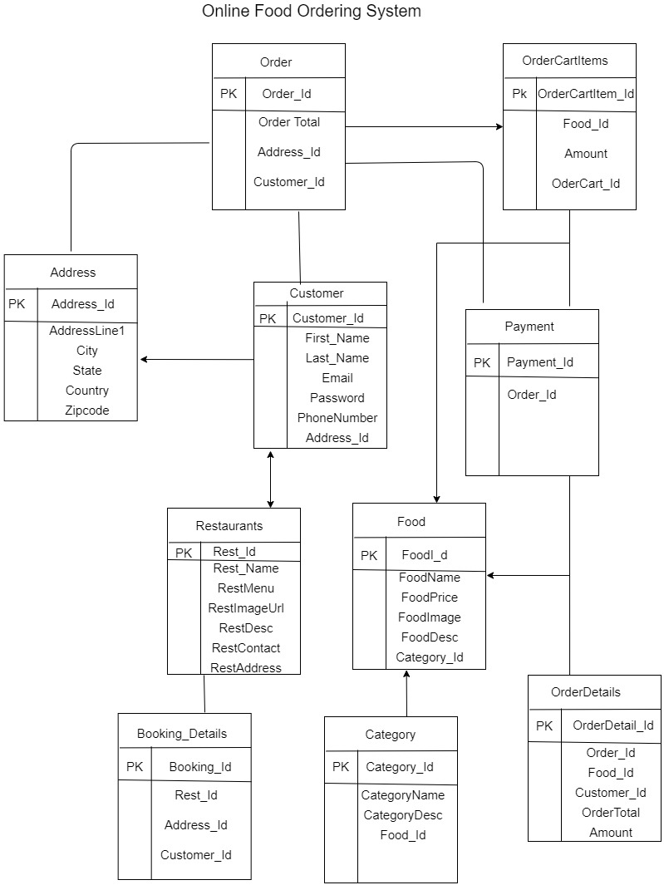
Database Schema
B

Slide 3
Classes Used
Name | Type | Functionality | Get Data
Customer | API | Contains customer information | Post data to database
Login | API | Provide access | Post data to database
Address | API | Contains address of the customers | Post data to database
Category | Static class | Contains list of food type | Get data from CategoryRepository
Food | Static class | Contains list of food | Get data from FoodRepository
Order | Static class | Give overall details of the order | Get data from database
OrderCart | Function class | Perform functions for the order class | Get data from other database
OrderCartItems | API | Show the cart items | Get data from other data
Restaurants | Static class | Contains list of restaurants | Get data from RestaurantRepository
Booking-Details | Static class | Confirm booking of restaurant | Get data from BookingRepository
Payment | API | Payment | Get data from database

Slide 7
Wireframe

